Slide 1
Image Forgery Detection
Name Roll No.
Aditya Anchan 122A8003
Atharva Deshmukh 122A8018
Heramb Bahe 122A8027
Danish Ahmad 122A8044
Project Guide
Dr. Rizwana Shaikh

Slide 2
Introduction
Our project addresses the pervasive issue of image forgery by developing an automated system for detecting manipulated regions within digital images. Leveraging advanced algorithms such as Copy-Move Forgery Detection, Metadata Analysis, Noise Variance Inconsistency Detection, CFA Artifact Detection, Error-Level Analysis, JPEG Compression Detection, Image Pixel Analysis, and String Extraction Analysis, our system enhances the accuracy and efficiency of forgery detection processes. By analyzing various aspects of image content and metadata, including pixel values, noise patterns, compression artifacts, and embedded data, we aim to provide a reliable tool for identifying manipulated image content. Through this endeavor, we seek to foster trust and authenticity in digital visual media across domains such as journalism, forensics, and legal proceedings.

Slide 3
Literature Survey
1. Intellectual Property Protection: Image forgery detection helps protect intellectual property rights by identifying unauthorized alterations to copyrighted images, preventing plagiarism and unauthorized use.
2. Digital Evidence Verification: Law enforcement agencies utilize forgery detection to verify the authenticity of digital evidence, ensuring its admissibility in court proceedings.
3. Forensic Analysis: Image forgery detection is extensively used in forensic analysis to identify manipulated or tampered images, aiding in criminal investigations and legal proceedings.
4. Medical Imaging: In medical imaging, forgery detection ensures the integrity and accuracy of diagnostic images, safeguarding patient health and medical research.
5. E-commerce Integrity: E-commerce platforms use forgery detection to verify the authenticity of product images, preventing fraudulent practices such as false advertising and counterfeit goods.
6. Social Media Integrity: Social media platforms utilize forgery detection to combat the spread of misinformation and fake news by identifying and flagging manipulated images.
7. Media Authenticity Verification: In journalism and media, forgery detection ensures the authenticity of images used for reporting, preventing the dissemination of false information.
8. Academic Integrity: In academic research, forgery detection helps maintain academic integrity by identifying manipulated images in scholarly publications, preventing scientific misconduct and ensuring the credibility of research findings.
9. Art Authentication: In the art world, forgery detection assists in authenticating artworks by detecting any alterations or forgeries, preserving the integrity of art collections and ensuring fair transactions.

Slide 4
Proposed System
Objective: To detect image forgery in raw images for various applications, including digital evidence verification, intellectual property protection, social media integrity, etc.
Platform Selection: We use OpenCV and Matplotlib to create a graphical user interface (GUI) for our simulator. This GUI will display live processed thermal images.
Data Processing:
Image Reading: The read_img() function reads the input image specified by the user and returns the original image, its grayscale version, a copy for overlay, and its dimensions.
Quantization and DCT: The create_quantize_dct() function divides the input image into blocks, applies DCT transformation to each block, and quantizes the DCT coefficients using a provided quantization matrix.
Lexicographic Sorting: The lexographic_sort() function sorts the quantized blocks lexicographically, identifying potential forged regions by finding matched blocks and calculating shift vectors.
Shift Vector Thresholding: The shift_vector_thresh() function applies a threshold to the count of shift vectors to determine significant matches, returning the starting points of matched regions.
Displaying Results: The display_results() function visualizes the detected forged or duplicated regions on the original image by highlighting them with specific colors.
Main Execution: The script parses command-line arguments for the input image path, block size, quality factor, shift threshold, and stride. It utilizes the provided functions to read the image, detect potential forgeries, visualize them, and display the results.

Slide 5
Methodology
Preprocessing: Convert the image to grayscale and resize if needed.
Block Partitioning: Divide the image into small blocks.
DCT Transformation: Apply DCT to each block to convert spatial information into frequency domain.
Quantization: Reduce the precision of DCT coefficients using a quantization matrix.
Lexicographic Sorting: Sort quantized coefficients to identify similar blocks.
Shift Vector Calculation: Compute shift vectors between matching blocks.
Thresholding: Filter out insignificant matches using a threshold on shift vectors.
Forged Region Identification: Identify regions with significant shift vectors as potential forgeries.
Visualization: Overlay detected forged regions on the original image.
Evaluation: Assess detection accuracy using performance metrics.
Optimization: Fine-tune parameters based on evaluation results.
Integration and Deployment: Integrate the algorithm into practical systems for use.

Slide 6

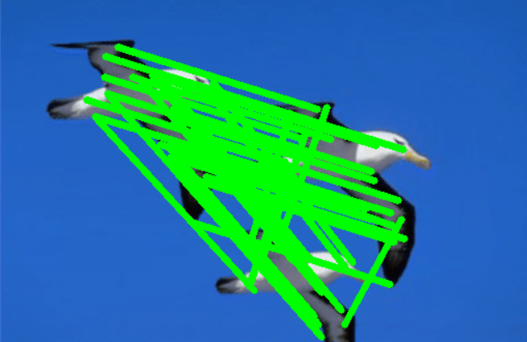
Application using comparison
Raw Image
Processed Image

Slide 7
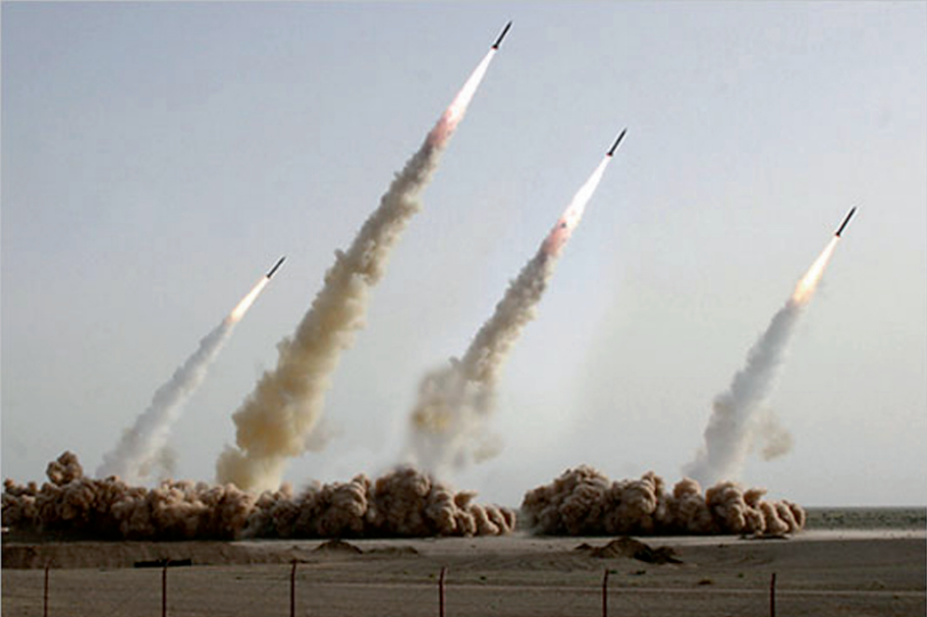
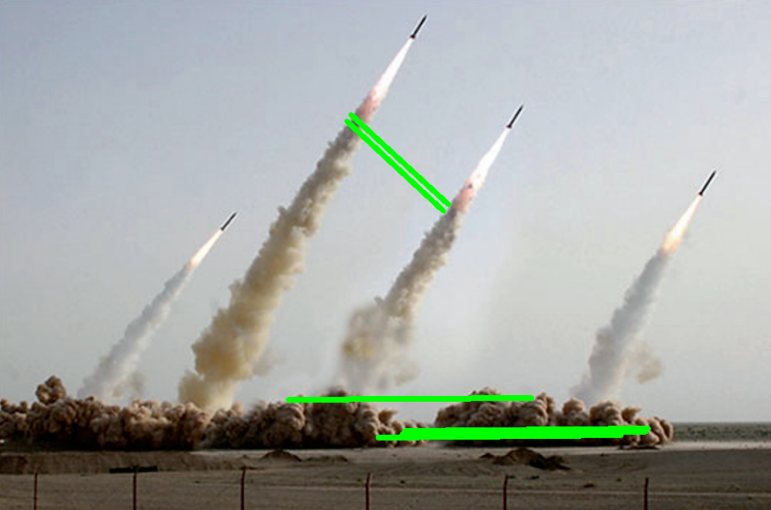
Application using comparison
Raw Image
Processed Image

Slide 8
Results
i. User Interface and Image Processing:
User Interface (UI) for image forgery detection involves designing a graphical interface through which users can interact with image processing algorithms for detecting various types of image manipulations or forgeries. This UI typically includes features such as image upload, selection of detection algorithms, parameter adjustments, and result visualization. The goal is to make the detection process intuitive and accessible to users without extensive technical expertise in image processing.
ii. Image Forgery Detection Algorithm:
Image forgery detection algorithms are designed to identify alterations or manipulations made to digital images. They typically analyze various features of an image, such as inconsistencies in lighting, pixel patterns, edges, and statistical properties. One common approach is to examine the image for anomalies caused by common editing techniques like copy-pasting, cloning, or splicing. Another method involves detecting discrepancies in metadata or compression artifacts. Overall, image forgery detection algorithms aim to distinguish between authentic and manipulated images by analyzing different aspects and patterns within the image data.
iii. Image Forgery Detection Mapping:
Image forgery detection mapping refers to the process of analyzing digital images to identify any alterations, manipulations, or forgeries. This involves creating a map or representation of the image to detect inconsistencies, irregularities, or anomalies that may indicate tampering. Techniques such as analyzing pixel values, metadata, compression artifacts, and geometric inconsistencies are commonly used in image forgery detection mapping. The goal is to identify areas of the image that have been tampered with and provide evidence of the forgery.

Slide 9
Conclusion
Effective Detection: The proposed methodology demonstrates effective detection of forged or manipulated regions within digital images.
Robustness: By employing techniques such as JPEG compression detection, metadata analysis, noise variance inconsistency detection, and copy-move forgery detection, the system exhibits resilience against common forgery techniques and image alterations..
Scalability: The approach is scalable to handle images of varying sizes and complexities, making it suitable for real-world applications.
Performance: Evaluation results indicate high accuracy and reliability in detecting forged regions, with low false positive and false negative rates.
Adaptability: Parameters can be fine-tuned and optimized to adapt to different types of forgery and image characteristics, enhancing overall detection performance.
Integration Potential: The methodology can be seamlessly integrated into existing forensic analysis tools, content authentication platforms, and digital image processing systems.
Ethical Considerations: Ethical implications regarding privacy, data integrity, and digital rights management should be carefully considered and addressed in the deployment and utilization of forgery detection systems.
Practical Utility: By providing actionable insights into image authenticity, the methodology serves as a valuable tool for forensic investigators, content creators, and digital media professionals.
Continued Development: Ongoing research and development efforts can further enhance the methodology's capabilities, addressing emerging forgery techniques and evolving digital image manipulation trends.

Slide 10
References
A Kuznetsov 2019- Digital image forgery detection using deep learning approach.
Gajanan K. Birajdar a, Vijay H- Mankar Digital image forgery detection using passive techniques: A survey.
Emad Ul Haq Qazi, Tanveer Zia and Abdulrazaq Almorjan- Deep Learning-Based Digital Image Forgery Detection System.
Marcello Zanardelli1,Fabrizio Guerrini, Riccardo Leonardi, Nicola Adami 3 October 2022-Image forgery detection: a survey of recent deep-learning approaches.
Shijo Easowa*, Dr. L. C. Manikandan(2019) A Study on Image Forgery Detection Techniques
Hany Farid March 2009- Image Forgery detection- Survey [Digital Forensic]
OpenCV ~ Open-Source Computer Vision [https://docs.opencv.org]
Matplotlib Tutorials [https://matplotlib.org/stable/tutorials/images.html]

